Slide 1


Predictive Fleet Maintenance Using Machine Learning
Krunal soni

Slide 2
About Scania & Vision
Driving the Future with Predictive Maintenance
🚛 About Scania
Scania is a global leader in heavy vehicle manufacturing, recognized for its performance, safety, and sustainability. Today, Scania is extending its expertise from a vehicle manufacturer into a data-driven transport solutions company.
💡 Vision & Strategy
At Scania’s Fleet Management & Data Analytics Division, our mission is to build intelligent, connected, and predictive system failure which helps to keep vehicles on the road longer and safer.
⚙️ Key Capabilities
📡 Real-time telematics from connected trucks
🧠 AI-driven predictive maintenance to prevent costly failures
💰 Maximized uptime and operational efficiency
📊 Data-informed decisions for global fleet operators

Slide 3
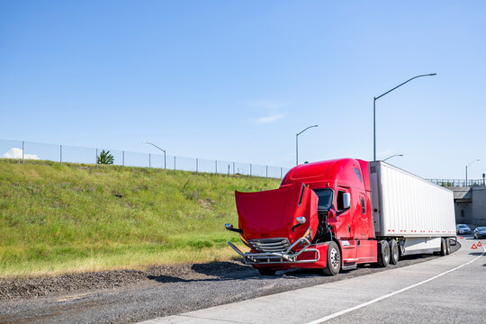
Business Problem When Downtime Costs Millions
Scania’s system data provides an opportunity to detect early warning signs of component failure. By predicting breakdowns before they happen, Scania can prevent costly repairs, avoid delivery delays, and improve fleet reliability.
Why this matters
🚚 Unexpected breakdowns disrupt delivery schedules.
💸 Reactive repairs drive up maintenance costs.
⏱️ Downtime reduces fleet efficiency and impacts customer satisfaction.

Slide 4
Business Impact
Reactive Maintenance (Before) | Predictive Maintenance (After)
🔧 Repairs only after breakdowns | 🧠 Issues detected before failure
🚛 Frequent unplanned downtime | ⏱️ Reduced downtime, higher fleet availability
💸 Costly emergency repairs | 💰 Planned maintenance, lower costs
🧯 Sudden part failures | ⚙️ Data-driven part replacement before failure
📅 Fixed-interval servicing (not optimized) | 📊 Condition-based servicing using sensor data
📦 Poor spare parts planning | 📦 Optimized inventory, minimal waste
⏳ Delivery delays & route disruptions | 🚚 On-time deliveries, smoother operations
😟 Loss of customer trust | 🤝 Customer confidence through reliability
⚠️ Risk to driver safety | 🛡️ Improved vehicle & driver safety
😞 Damage to brand reputation | 🌟 Stronger brand image & trust

Slide 5
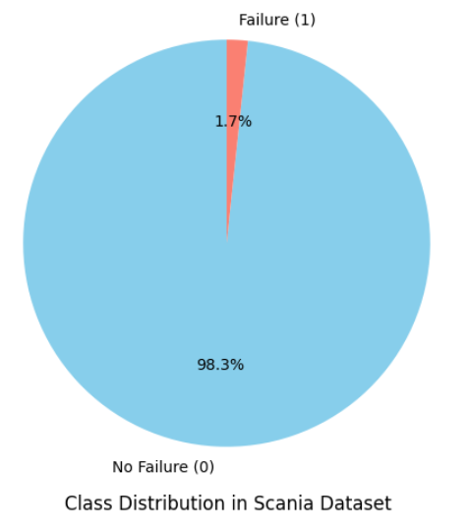
Dataset Information
170 Sensor Features (Numerical readings from vehicle sensors)
2-Class Classification Problem
Class 0: Normal (Non-failure)
Class 1: Failure (Fault detected)
Train Dataset
60,000 Total Samples
1,000 Failure Samples (~1.67%)
Imbalanced: Majority class dominates
Test Dataset
16,000 Total Samples
375 Failure Samples (~2.34%)

Slide 6
Preprocessing Pipeline
Handle Missing Values
Remove features with high null values, Impute with median
Drop Correlated Features
Remove highly correlated (|r| > 0.9), Reduce multicollinearity
Feature Scaling
Normalize features by standardizing scale for model stability
Balancing Data
Oversampling of minority class for balance distribution

Slide 7


Machine Learning Approaches
Logistic Regression
Interpretable linear model
Fast and simple to deploy
Used as baseline classifier
Gaussian Naive Bayes
Probabilistic, assumes Gaussian features
Effective for high-dimensional numeric data
Fast training and inference
Summary
Both models were evaluated for predictive power and generalization. Chosen for simplicity, speed, and suitability for imbalanced fault detection tasks.

Slide 8
Model Training Process
Step-by-Step Supervised Learning Workflow
Split: Training, Validation, Test Sets
Logistic Regression
Gaussian Naïve Bayes
Divide dataset to prevent overfitting
A classification algorithm for binary outcomes
Probabilistic Classifier based on Bayes’ theorem
Evaluation Metrics
Confusion Matrix
Visualize true vs predicted classifications
Measures accuracy, precision, recall, F1-score

Slide 9
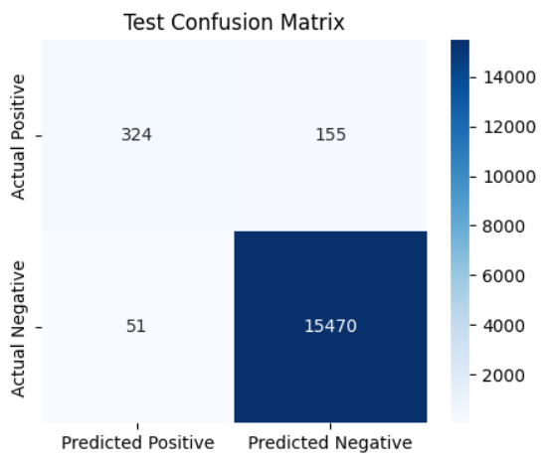
Visual Confusion Matrix
Term | Meaning | Real-World Interpretation
TP | Failure correctly predicted | You scheduled maintenance → avoided breakdown ✅
FP | Predicted failure, but truck was actually fine | You serviced unnecessarily → wasted maintenance cost ⚙️
FN | Predicted fine, but failure actually happened | Truck broke down unexpectedly → costly downtime 🚨
TN | Correctly predicted fine | Truck runs smoothly ✅
TP: 324 | FP: 155
FN: 51 | TN: 15470
FN (Missed Failure) – High Risk – Low FN, High Recall
FP (False Alarm) – Moderate Cost – Acceptable to some Extent

Slide 10
Model Performance Result
Focus Metric → Recall (Sensitivity)
Recall - Measures how many actual failures - model correctly caught.
High Recall = Fewer missed failures (low FN)
Low Recall = You’re missing real faults
Logistic Regression |  | Gaussian Naive Bayes
TP: 324 | FP: 155 | TP: 343 | FP: 528
FN: 51 | TP: 15470 | FN: 32 | TN: 15097
Accuracy: 0.9871 | Precision: 0.6764 Recall: 0.8640 | F1: 0.7588 |  | Accuracy: 0.9650 | Precision: 0.3938 Recall: 0.9147 | F1: 0.5506
Key Insight:
Recall is critical → We prefer slightly more false positives (FP) rather than missing actual failures (FN).
Logistic Regression outperformed Gaussian Naive Bayes by achieving a better balance between precision and recall, indicating more reliable fault detection with fewer false alarms.

Slide 11

Conclusion
📊 Key Outcomes
Comprehensive data preprocessing: handled missing values, scaled features, and balanced classes.
Models built from scratch — Logistic Regression & Gaussian Naive Bayes.
Best performance: Logistic Regression with balanced Precision (0.68) and Recall (0.86).
Naive Bayes strength: High recall for early fault detection.
💡 Impact
🌍 Business Value
Supports Scania’s vision of proactive, data-driven maintenance, enabling smarter logistics and sustainable operational excellence.
⚙️ Reduced unplanned breakdowns | 💰 Lower maintenance costs
🚛 Improved fleet reliability | 🔒 Enhanced driver safety

Slide 12
Thank you
Questions?

